Slide 1
Indian Agriculture Analysis

Slide 2
agenda
Introduction
Dashboards
Explaination

Slide 3

Introduction

Slide 4
Introduction
This project aims to conduct a comprehensive analysis of Indian agriculture, focusing on district-wise and year-wise data. The dataset provides detailed information on various crops, their areas, production, and yields across different districts and years. The goal is to leverage Power BI to create interactive visualizations that uncover trends, patterns, and disparities in agricultural practices, enabling stakeholders to make informed decisions for sustainable farming and resource allocation.

Slide 5

Dashboards & Explaination

Slide 6
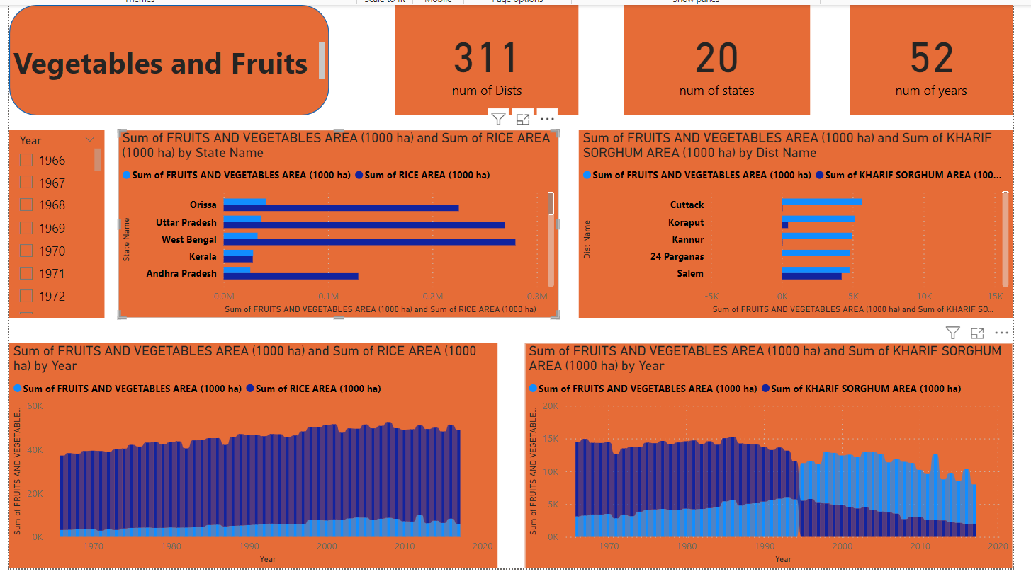
First Dashboard

Slide 7
First Explanation
From the first dashboard that focus on Vegetables and fruits we will find that the most areas that concern on them are cuttack, koraput and Kannur.
We have 311 distinations and 20 states and the total we will analyze them are 52 years
We will find some relationships with Vegetable and Fruits with KHARIF this relations is crops in KHARIF increase with increasing Veg & FRUITS but the increasing in KHARIF crops is much bigger than Veg & FRUITS
we will find that the most stats that concern on them are Orissa, Ottar Pradesh and West Bengal.

Slide 8
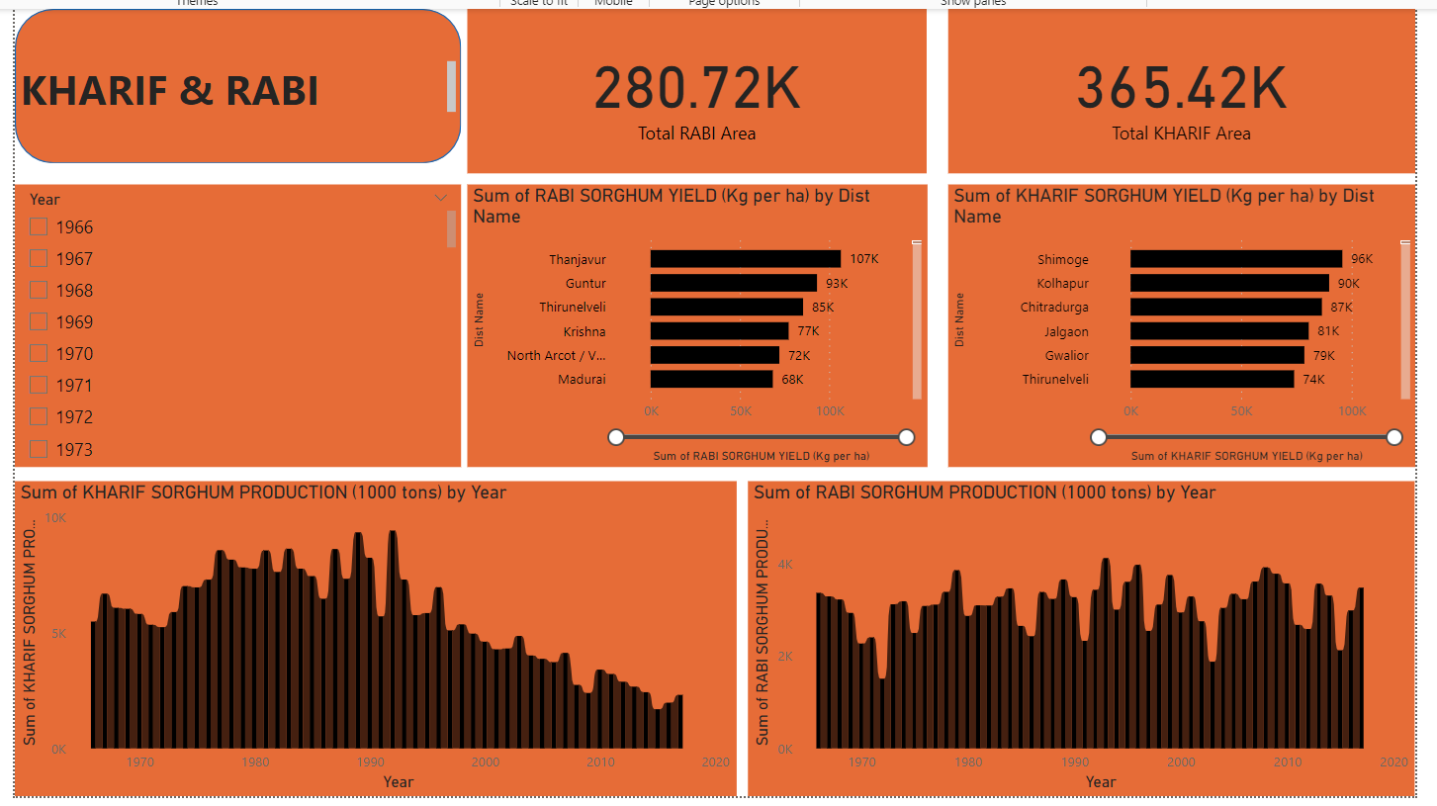
Second Dashboard

Slide 9
second Explanation
We will find from the previous dashboard that total RABI cultivated area is 280.72K and the total KHARIF cultivated area is 345.42K.
The Poduction of KHARIF crops decreased over the year but I noticed that the peak of KHARIF crops was between 1975 to 1990 that’s mean this peak for almost 15 years.
The production RABI crops is almost constant over years but I noticed that the most time has the higher production was between 1990 to 2000.
The most states Yielded in KHARIF are Shimoge, Kolhapur and chitradurga.
The most states Yielded in RABI are Thanjavur, Guntur and Thirunelveli

Slide 10
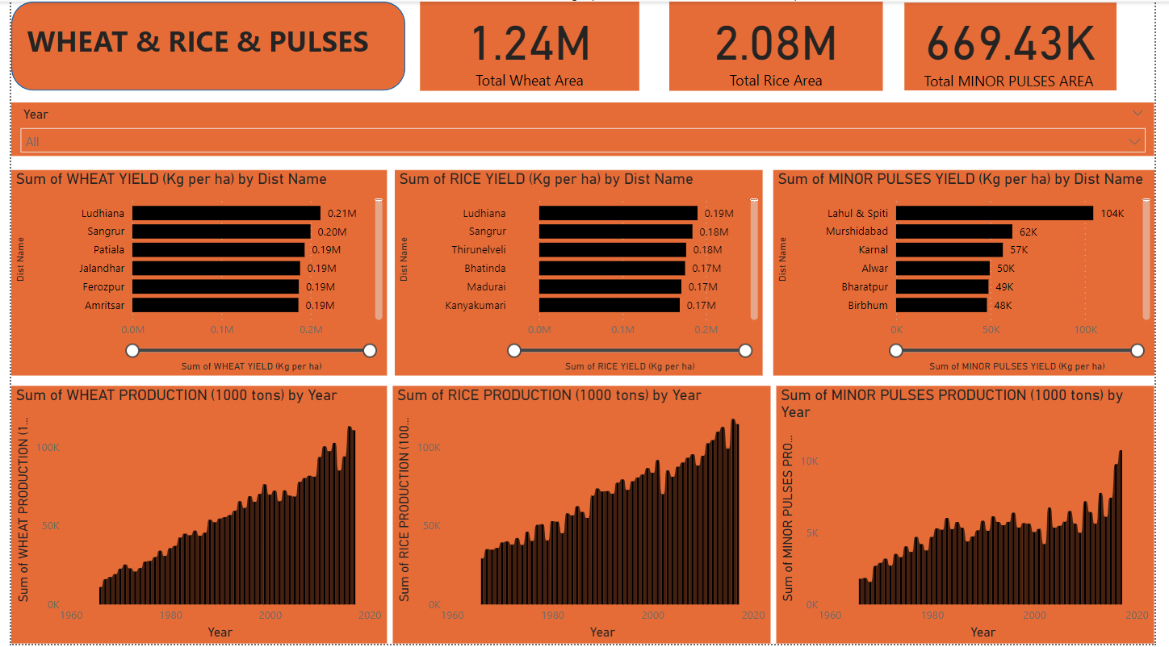
Third Dashboard

Slide 11
Third Explanation
In this Section I will analyze three crops wheat , rice and Pulses.
We will find from the previous dashboard that total wheat cultivated area is 1.24M , the total Rice cultivated area is 2.08M the total Pulses cultivated area is 669.43K.
All our three crops grow over years but I found a mutation in pulses growth in last 3 or 5 years .
The most states Yielded in Wheat are Ludhiana, sangrur and patiala.
The most states Yielded in Rice are are Ludhiana, sangrur and Thirunelveli.
The most states Yielded in pulses are lahul & Spiti, Murshidabed and Karnal.

Slide 12
Thank you

